Slide 1
Object Oriented Programming
Kia Babashahi Ashtiani

Slide 2
Outline Of OOP
What is OOP
Why do we need OOP?
OOP characteristics.
Static VS none static
Method over loading and documentation.
toStrings
Unit tests and debugging.

Slide 3
User defined classes
Java is an Object Oriented language.
Almost everything in Java can be viewed as an object of something. But what does that mean?
Informally, objects are instances of classes.
But what are classes?

Slide 4
Classes: Informal definition
A class can be viewed as a complex entity. Something like a category.
Cat is a class.
A cat you see on the street is an instance of class cat.
Dog is a class.
A dog is an instance of the class dog.
Human is a Class.
You are an instance of the class Human.
Apartment is a class.
The apartment you are living in is an instance of the class apartment.

Slide 5
Classes: Informal definition
A human has some attributes or field such as blood type and height.
A human also has a set of behaviours or methods such as thinking and breathing.
Any instance of the human class must have both of these features.

Slide 6
Attributes and methods informal
Cats:
Fields: Normally have four legs two eyes and a weight.
Methods: They meow. It will be really strange to see a cat that barks.
Mobiles :
Normally have a screen.
Preform actions such as calling or playing music.

Slide 7
Private vs public: Informal
As a human your height, eye color, etc.,… are public to every one.
Your thoughts are private to yourself meaning that you can share them if you like to who you like.
It also means you are the only one who can manipulate them.
If you want someone to influence them, you let them somehow.

Slide 8
A class in Java
Is a combination of methods (functions) and Attributes(fields).
Each attribute and method in a class usually comes with an access modifier keyword:
public: Every class in the package or another class that calls the package has access to that element.
private: No class outside of the class itself can access the element.
protected (programming 2).

Slide 9
Jungle example
Imagine a project called jungle.
You can find multiple classes in this project like: Class Tree, Class Lion, Class Elephant, Class Zebra, …. .
In a given jungle, you will find multiple instances(object)of the elements above.

Slide 10


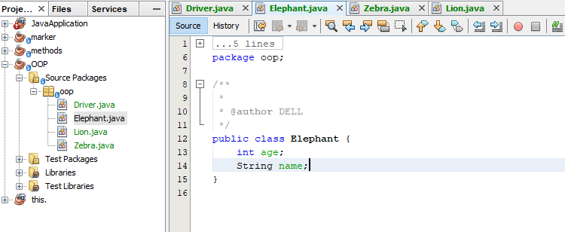

Elephant class
z

Slide 11
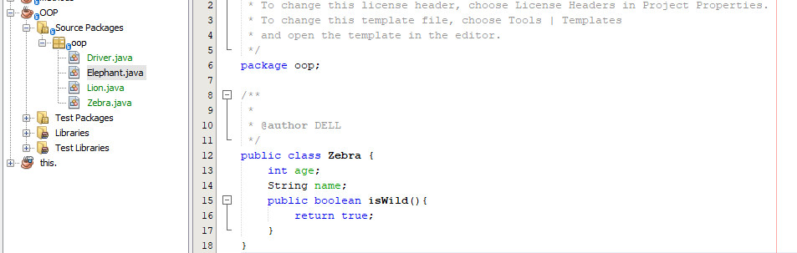
Zebra class
z

Slide 12
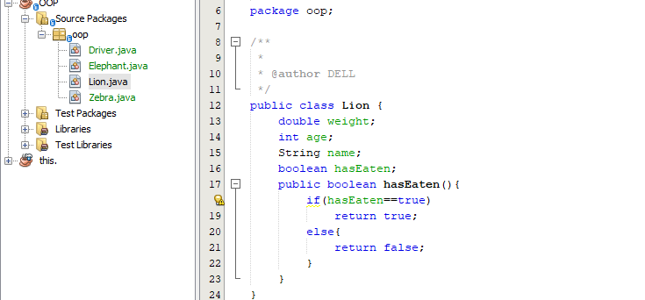
Lion class

Slide 13
Main function
A class is called an application if it consists of a main function.
The main class (the class that contains the main function) will make the code executable.
If a class does not contain a main function, it can not be executed.
The main is like the brain that organizes the connection between the multiple objects in your body like your hand, heart, eyes , …
We usually separate the class containing the main method and call it the driver or tests or the main class.
Map analogy.

Slide 14
Class definition
The name of the classes has to be in Camel Case.
Camel Case naming for classes: The first letter of each word has to be in Upper Case. Example :
PartTimeEmployee, Animal, Lion, Student, HealthWorker, …
Classes are usually defined public in Java: You need to create instance of them.
To Create them, create a project as you have done so far.
Then right click on the project icon and press add a class.

Slide 15
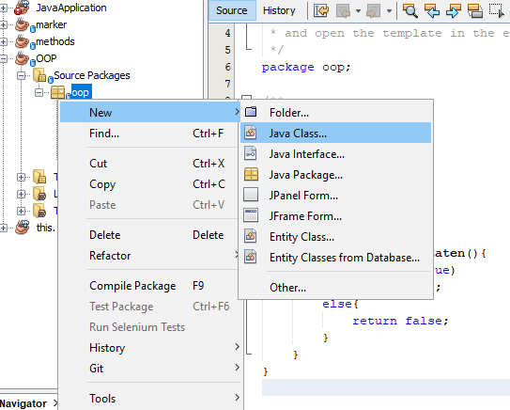
Creating a class
z

Slide 16
Class example: Elements of a class
Package name,
Class name,
Variables (global) Also known as fields or attributes.
Methods.
Constructor(To be taught)

Slide 17
No main no run
A class is like a map.
You can not live in a map.
What you can do is to create a building from the map and live in it.
That is what we are going to do. Instantiate or create objects.
When you create objects, you can customize them the way you like.
For example: One apartment is painted white, the other is painted brown or orange. One apartment has three bath rooms the other has one.

Slide 18
Create instances of classes.
Objects of classes can be created in other classes.
We will start by creating objects of different classes in the main class. But that is not limited to the main class.

Slide 19
Example
Lets create a class called Student.
Each student has a:
Name : String
Student Id: int

Slide 20
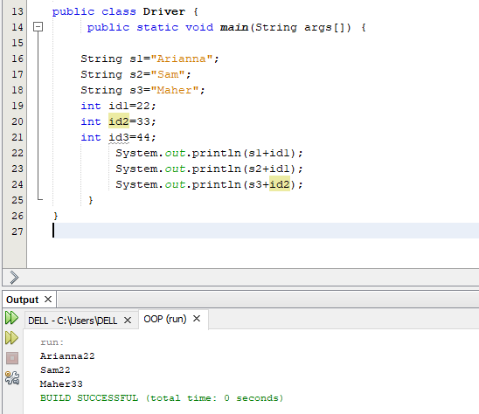
Not using OOP how would this look like?
No real relation is defined
Only a print statement is visible.

Slide 21
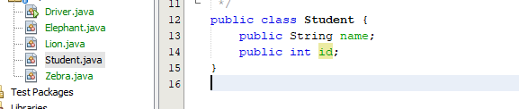
Student class
As you can see the class has it`s fields/attributes listed.
These attributes are global to the class.
In this example the attributes are public but this will change.

Slide 22
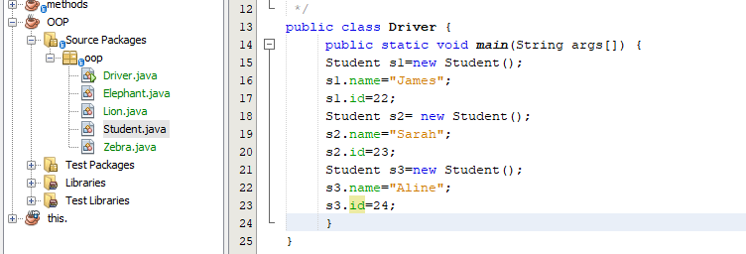
Example: Creating a student
In this code, student s1,s2,s3 are being created and their names and ids are being defined.

Slide 23
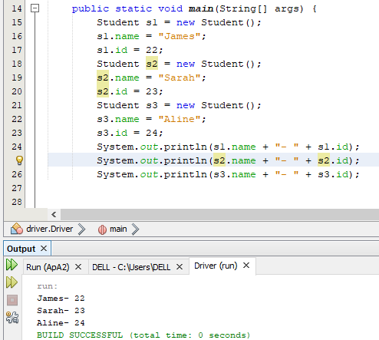
Students

Slide 24
Static vs none static
Normally in java, if we want to use some methods of a class or some of its parameters we need to create an instance of them and put them in the memory. The code
Student s1= new Student(); does this for us.
It creates an instance of the class student, and allocates some memory of size Student() to this object (initializes it).
In other words if you want to talk to a human you need an instance of the class human to talk to.

Slide 25
Static vs none static
Normally, first an object of that class needs to be created.
Then the object is placed inside the memory and initialized.
Then you can start manipulating it.
The object can be created in an other class. Let it be the main class or another:
A department has a human as its manager.
If in order to access the methods of a class we need to create an object of it in another class and eventually run the application in the main class, where do we initialize the main class?
Static functions and variables are a special types of elements that you can run them independent of the object that is calling them like the math class.
Somehow these classes are loaded into the memory statically and don’t need someone to create an object from them.

Slide 26
Public static void main()
In informal terms the main method is declared static because it is the manager of the project or where we start of our application.
It does not return anything.

Slide 27
Static vs none static
So if you are coding in the main class, all methods should be static. Since they are in the class that must create everything.
If you are coding in other classes all your methods should be none static. (I will take out points if the methods in your classes are static unless they are in the main class).
What is static is launched in the memory and is ready to be launched.
What is none static has to wait until an object is created that assigns memory to it.
Static elements will stay in the memory and is not efficient if not static garbage collection might do the trick for us. (will be talked about later).

Slide 28
Practice
In the lion class:
Add a void method roar();
Add an int attribute age;
Add a String attribute location.
In the main class:
Create three different lions.
Print their ages together with their locations: See how connecting them makes sense now.

Slide 29
Private
As you can observe, the main class has access to all of the attributes of your lions. Try creating a lion l1 and then setting its age to 4; You will see that this is possible.
How can I limit the access of other classes to my attributes?
Use the access modifier keyword: private
If something is defined as private(method or field), it can not be accessed outside that class directly.
Change the location attribute in the lion class to private. Then go to the main class and type l1.location (you will see an error as location will not be displayed as it is private).

Slide 30
Code
If you don`t specify if a variable is private or public, it will be considered public.
Our lion does not want to share its location or what it is going to eat with anyone outside the class. But any other method inside the lion class has access to its private elements. Look at the next slide.

Slide 31
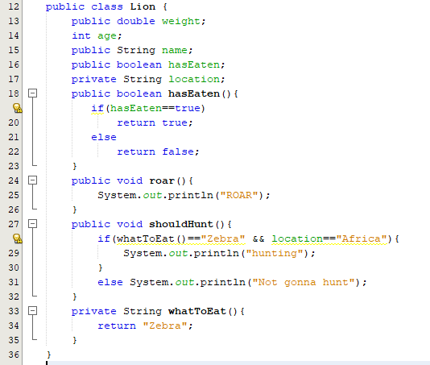
Lion with private methods and fields
z

Slide 32
Setters and Getters
Lion is a map. We create lions from the lion map. If the location in the lion map is private and we cant access it outside the lion class (where we are creating objects). What should we do?
Create two methods in the Lion class:
Public void setAge(int age): Sets the age
Public int getAge(int age): returns the age.
Setters are ways to modify private fields (or all of the fields in general) in java.
Setters allow us to ask for authentication or the avoid giving direct access to other classes.
Getters are then used to obtain the value of the modified variable.

Slide 33
Setter and getter example
Set the values of the attribute using setters.
Get these values using getters.
Next slide provides you with some examples.

Slide 34
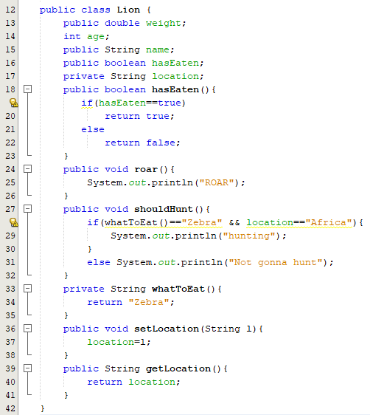
Setters and getters Lion Class
z

Slide 35
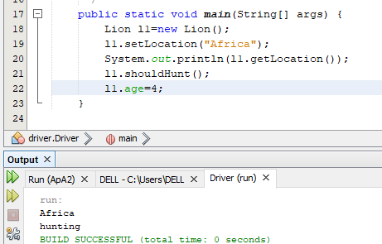
Creating Lions
The location is set to Africa in line 19.
The location is printed in line 20.
The fact that shouldHunt is printing hunting shows that the assignment of the location was successful.

Slide 36
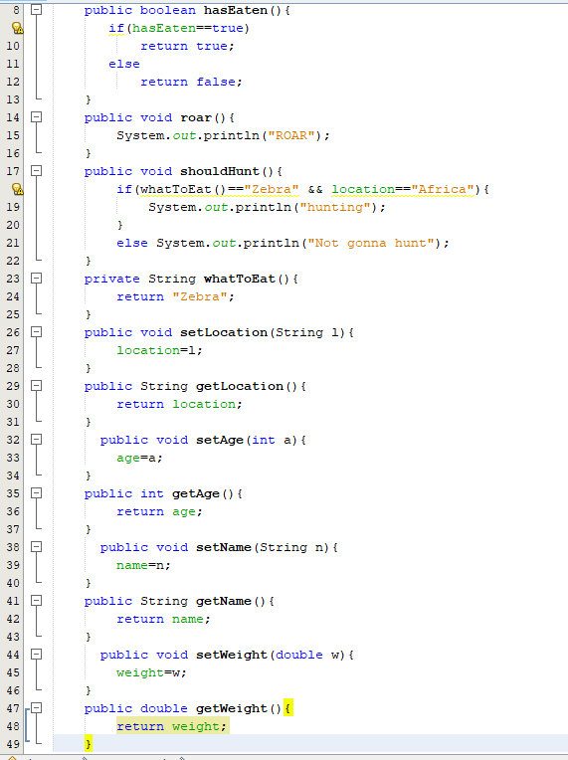
Lion Class Completed
Using setters and getters to respect the protocol.
Good programming hint: Try to have as many as your attributes and methods private as possible.

Slide 37
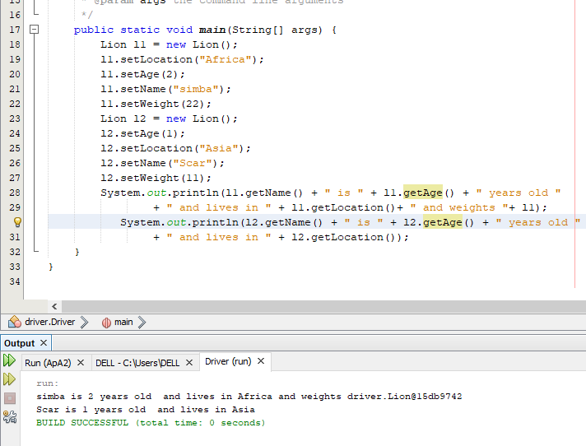
Lions
Next, try to do the same with zebras.
Play with the private and public elements.
Add methods to the lion class: Note that those methods should not be static since you will create objects from the lion class .

Slide 38
Wrap up
OOP用于编写模块化代码
OOP允许我们封装方法和字段
OOP允许我们修改对类的访问。
静态方法和变量直接在内存中启动。
静态元素无需等待，直到从它们创建对象为止。
目前，主类中的所有方法都必须是静态的。
除非另有说明，否则其他类中的任何方法都不应声明为静态。
OOP is used to write modular codes
OOP allows us to encapsulate methods and fields
OOP allows us to modify access to our classes.
Static methods and variables are launched in the memory directly.
None static elements need to wait until an object is created from them.
All methods in the main class have to be static for the time being.
None of the methods in other classes should be declared static unless stated otherwise.
封装method

Slide 39
Next
Garbage collection
More on OOP and setters and getters.
Constructors.
toString.
Then introduce overloading.
Nested classes.

Slide 40
OOP features
There are four characteristics to object oriented programming.
Encapsulation: Combining methods and data in one entity.
Helps int keeping the data safe and secure from outside
Inheritance: When a class inherits things from their parent class.
Helps us code less and make less errors.
Polymorphism: Having multiple forms for the same objects.
Provides more versatility in coding.
Abstraction: Representing data in a very abstract way.
Helps with management and future development.

